Slide 1
Post-Audit Alternative Dispute Resolution
IRS ADR Strategies: Evaluating and Leveraging ADR Options in Tax Disputes
March 24, 2011
Strafford CLE/CPE Webinar
Presentation by:
Todd Welty, Partner, Dentons, Dallas
todd.welty@dentons.com

Slide 2
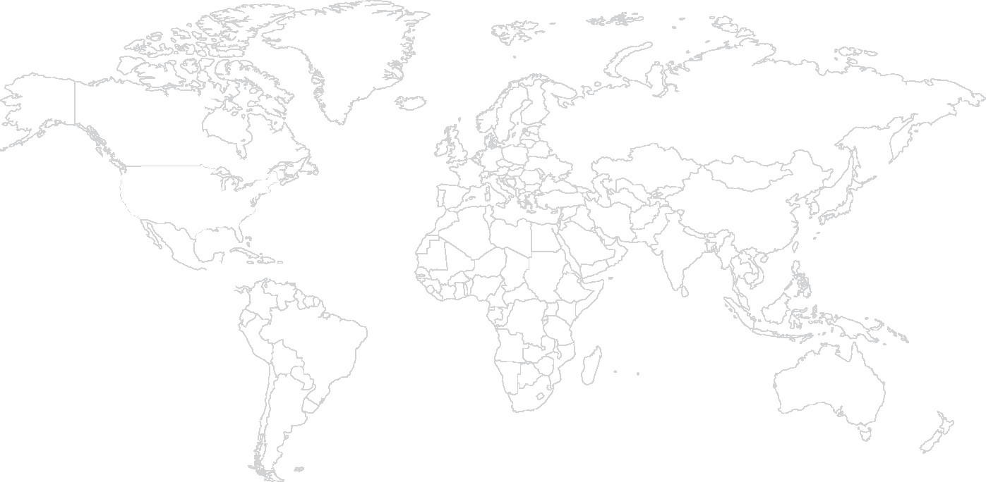
Locations

Slide 3
Offices by list
Key |  | Canada |  | United States |  | Europe |  | Central and Eastern Europe |  | Africa |  | Middle East |  | Asia Pacific
l Offices Ð Associate offices ¡ Facilities u Associate firms + Special alliance firms |  | l Calgary l Edmonton l Montréal l Ottawa l Toronto l Vancouver |  | ¡ Atlanta ¡ Boston l Chicago l Dallas l Kansas City l Los Angeles ¡ Miami ¡ New Orleans l New York l Phoenix l San Francisco l Short Hills l Silicon Valley l St. Louis l Washington, DC |  | l Barcelona l Berlin l Brussels l Frankfurt l Madrid l Paris u Zurich |  | l Bratislava l Bucharest l Budapest l Istanbul l Prague l Warsaw |  | u Accra u Algiers u Bissau u Bujumbura l Cairo u Cape Town u Casablanca u Dar Es Salaam u Johannesburg u Kampala u Kigali + Lagos u Luanda u Lusaka u Maputo u Nairobi u Nouakchott u Port Louis u Praia u São Tomé u Tripoli |  | l Abu Dhabi Ð Amman u Beirut l Doha l Dubai Ð Kuwait City l Manama l Muscat Ð Riyadh |  | l Beijing l Hong Kong l Shanghai l Singapore
 |  |  |  |  |  | United Kingdom |  | Russia and CIS |  |  |  | Central Asia
 |  |  |  |  |  | l London l Milton Keynes |  | l Kyiv l Moscow l St. Petersburg |  |  |  | l Almaty u Ashgabat l Baku l Tashkent

Slide 4
Outline of Presentation
Recent Emphasis on ADR in Tax Cases
Benefits & Challenges of ADR
Pre-docketing and Post-docketing Appeals
Post-Appeals Mediation
Binding Arbitration

Slide 5
Recent Emphasis on ADR in Tax Cases
December 20, 2010, Tax Court proposed changes to Tax Court Rules to emphasize ADR:
Proposed Rule 124
Current Rule only provides for voluntary binding arbitration.
Revised Rule provides for voluntary binding arbitration, non-binding mediation, and “other methods of dispute resolution.”
IRS test programs for mediation and arbitration in certain cases:
E.g., IRS Announced extension of test program in offer and compromise and Trust Fund Recovery cases in Appeals, through December 31, 2012 (in certain locations).

Slide 6
Challenges of ADR
Certain ADR procedures may be more useful at different stages in the proceedings and throughout litigation.
Cases involving multiple issues and multiple years can present difficulties in obtaining an agreed resolution.
Choosing the appropriate ADR methods for the case is crucial; each case is unique.

Slide 7
Post-audit Appeals
Out of every exam, the taxpayer has the right to go to Appeals, if sufficient time on the statute of limitations remains.
Taxpayer will receive the revenue agent’s report and 30 day notice to file an appeal upon close of the audit (60 days in TEFRA partnerships).
Taxpayer has the option to appeal.
If taxpayer does not appeal, the appropriate statutory notice (FPAA in TEFRA partnerships) is issued.
The taxpayer can then decide to either pay the tax and seek a refund or file a petition in Tax Court.

Slide 8
Post-audit Appeals
Mission of Appeals:
“To resolve tax controversies, without litigation, on a basis which is fair and impartial to both the government and the taxpayer, and in a manner that will enhance voluntary compliance and public confidence in the integrity and efficiency of the Service.” IRS.gov
In most cases, docketed or non-docketed, the taxpayer should utilize Appeals:
Appeals provides an opportunity to reach a settlement on the tax liability, settle certain issues, and if nothing else, gather information from the IRS.

Slide 9
Pre-docketing Appeals
Benefits of pre-docketed Appeals:
Taxpayer can wait to choose the appropriate court, i.e., whether to pay and seek a refund or to petition the Tax Court;
Taxpayer has an opportunity to prepare the case before it is filed;
Taxpayer can obtain information about the IRS position that he did not obtain from the revenue agent (taxpayer is entitled to information under Freedom of Information Act); and
Provides an opportunity to tell the taxpayer’s story.
Appeals submissions can be binding.

Slide 10
Pre-docketing Appeals
Extending the statute of limitations:
Appeals agents often seek an extension of the statute in order to continue settlement negotiations and hold the case in Appeals before issuing the statutory notices.
Extension may be appropriate in certain cases.
Taxpayer can negotiate an agreed extension or, in theory, an extension limited to certain issues.
The downside is there is little pressure on Appeals: docketed cases often receive priority.

Slide 11
Post-docketing Appeals
Docketed cases which have not previously been considered by Appeals are automatically referred to Appeals.
Unless Area Counsel, Chief Counsel, and Appeals believe the case should not be considered by Appeals. Rev. Proc. 87-24; I.R.M. 8.4.1.1.
If the parties are able to reach an agreed settlement in Appeals, the settlement is effected by a stipulation and is ordered by the court.
Neither party can appeal the order.
Case can be partially settled: Appeals and Counsel will prepare agreed issues for filing in court.

Slide 12
Cases Involving Tier I or Tier II Issues
LB&I adopted the Issue Tiering System in 2006 to ensure uniform treatment of high-risk compliance issues.
A list of Tier I, II, and III issues can be found at http://www.irs.gov/businesses/corporations/article/0,,id=200567,00.html.
Tier I issues are of “high strategic importance” and have a significant impact on one or more industries, e.g.,
All abusive and listed transactions;
Foreign tax credit generators; and
Research credit claims.
Tier II issues involve a large number of taxpayers, a significant dollar amount, emerging issues, or pose a substantial compliance risk or high visibility.

Slide 13
Tier I & Tier II Issues at Appeals
In Tier I cases, Appeals has no authority to settle the case or a particular issue in any manner other than pursuant to the proscribed guidance.
One-size-fits-all approach
Little discretion; strict compliance with guidelines
In Tier II cases, Appeals apparently has more discretion than Tier I, but still limited
Appeals will designate a Technical Guidance Coordinator to represent Appeals with respect to a tiered issue.

Slide 14
Technical Guidance Coordinator
Technical Guidance Coordinator:
Evaluates the hazards of litigation and help reach settlement
Must approve any settlement agreement
Ensures that settlement offers nationwide are comparable
Works under standardized settlement guidelines and IRS settlement position, which can create inflexible and untailored offers
Works under an undisclosed cap on concession
Cases where issues can be severed may be easier to settle
Related issues can be challenging

Slide 15
Cases Involving UTP Issues
In late 2010, the IRS significantly broadened taxpayer reporting requirements by issuing Schedule UTP to require certain corporations to report uncertain tax positions.
There is no provision for ADR for UTP issues.
Several comments received requested the IRS reserve programs like CAP and ADR forums for taxpayers who comply in good faith with Schedule UTP requirements.
It is possible ADR will be entirely unavailable in UTP cases.
ADR is unavailable in Voluntary Disclosure cases.
Officers have no discretion to concede in Voluntary Disclosure cases.

Slide 16
Settling a Case at Appeals
Understand the IRS position related to the issues;
Know your facts (and the implications);
Prepare adequate documentation to support facts;
Run the numbers—know your bottom line;
Provide all relevant law necessary for the Appeals Officer to make a favorable determination;
A face-to-face conference is preferred;
Decide attendees
Client should be accessible (via phone)
Discuss the strengths and weaknesses of case; and
Prepare closing agreement quickly thereafter.

Slide 17
Settling Tier I or Tier II Case at Appeals
Additionally, if the case involves a Tier I or Tier II issue:
Understand the IRS position related to the Tiered issue;
Settlement guidelines may be less established for newer issues, creating more flexibility.
Review recent settlements in similar cases to get a feel for possible concession;
Distinguish your facts;
Avoid presenting new legal authorities, if possible;
Highlight litigation hazards; and
Consider other issues, e.g., future years and Joint Committee review.

Slide 18
Post-Appeals Mediation
Either the taxpayer or Appeals may request post-appeals mediation on any unresolved issue:
at the close of Appeals;
when closing agreements are unsuccessful; or
when a compromise is unsuccessful.
Rev. Proc. 2002-44.

Slide 19
Post-Appeals Mediation
Non-binding
Mediator helps parties compromise to reach a settlement.
Mediator:
Parties can agree on an appointment;
IRS can appoint a trained Appeals Officer; and
Taxpayer can elect to have a non-IRS mediator as co-mediator.
IRS is advised not to mediate where it would delay discovery or trial.

Slide 20
Post-Appeals Mediation Availability
Not available in every case.
Generally available in cases where a limited number of legal and factual issues remain unresolved following settlement discussions in Appeals.
Only available for factual issues not covered by specific procedures, including Technical Advisor Program and Appeals Technical Guidance Program (Tiered issues).
E.g., Appeals recently denied in case where taxpayer claimed a I.R.C. § 6404(g) good faith exception for listed transactions.
Only one shot—unavailable if previously attempted.

Slide 21
Post-Appeals Mediation Availability
Available in Tax Court docketed cases:
If parties can reach an agreement on all or some of issues:
Counsel will draft a stipulation of agreed issues or the decision document to be submitted to the court.
If parties cannot reach an agreement, they prepare for trial.
NOTE: Although the proposed Rule 124 providing for mediation is not yet adopted, the Tax Court has long allowed for mediation in docketed cases.

Slide 22
Post-Appeals Mediation Unavailable
Unavailable in certain types of cases, including:
Cases involving issues which have been designated for litigation;
Collection issues;
Issues for which mediation would not be consistent with sound tax administration;
Where resolution with respect to one party would result in inconsistent treatment in the absence of participation by another party;
Cases where the taxpayer did not act in good faith during settlement agreements; or
Other issues identified by the IRS as excluded.

Slide 23
Outcome of Post-Appeals Mediation
If the parties can agree on all or some of the issues, Appeals will generally use a specific closing agreement to close mediation.
If the parties cannot reach an agreement:
Request binding arbitration (if the issues meet the requirements) or
Pursue litigation of case.

Slide 24
Binding Arbitration
Parties agree to have a third party make a decision about factual issues.
Must be approved by Appeals
Parties jointly select an Arbitrator—either Appeals Officer or non-IRS.
Procedure and findings are confidential.
Can be utilized by parties during Appeals to settle a severable issue.
Case is closed under normal Appeals procedures.

Slide 25
Drawbacks of Binding Arbitration
BINDING
Non-preferred method of ADR
Taxpayers and their representatives are generally opposed to a binding determination
Unpredictable results
Not available for all issues
Not issues designated for litigation or concerning the Technical Advisor Program (Tiered Issues)
Findings are not precedent

Slide 26

Thank you
Dentons US LLP
2000 McKinney Avenue Suite 1900 Dallas, TX 75201 USA
Dentons counsel drafted this paper for a specific event which occurred in the past. As such, it reflects the state of the law at the time it was drafted, and is not necessarily a reflection of current developments. For an update on this topic, please contact the editors of USTaxDisputes.com.
IRS Circular 230: We inform you that any US federal tax analysis contained an any blog post, email, attachment, or other writing (including any attachments), unless specifically stated otherwise, is not intended or written to be used, and cannot be used, for the purpose of (i) avoiding penalties under the Internal Revenue Code or (ii) promoting, marketing or recommending any transaction or matter addressed herein to another party.
© 2013 Dentons
Dentons is an international legal practice providing client services worldwide through its member firms and affiliates. This publication is not designed to provide legal or other advice and you should not take, or refrain from taking, action based on its content. Please see dentons.com for Legal Notices.

